Slide 1

SpotCheckAI: Deliverable 1
Rafferty Leung

Slide 2
Agenda
Team Member Roles and Responsibilities
Problem Statement/Description
Team Working Agreement
Personas
Minimum Viable Product
Technologies Implemented
Algorithms Employed
Diagrams
Product Backlog
Sprint 1 Backlog
Metrics
Retrospective
Sprint 2
MVP Demo

Slide 3
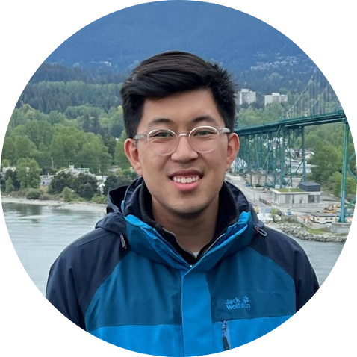
Team Roles and Responsibilities
Responsibilities:
Write and test code to ensure high-quality software that meets requirements.
Troubleshoot and debug code to identify and fix issues.
Ensure software scalability, performance, and security.
Work with project managers to estimate development efforts and deliver on time.
Define and prioritize the product roadmap and features based on user needs and market trends.
Gather and analyze user feedback and market research to inform product decisions.
Create and manage product requirements and specifications.
Rafferty Leung
Software Engineer, Product Manager

Slide 4
Problem Statement
The current average wait time to see a physician, regardless of their specialty, is 26 days. When diagnosing skin cancer, the process involves scheduling a dermatology appointment, undergoing a visual inspection, and sending the sample for pathology review. This process is time-consuming and can cause delays in treatment for patients.
To address this issue, a proposed solution uses machine learning algorithms to triage patients effectively. By analyzing skin lesion images, the application would be able to identify cases with a higher certainty of being cancerous, allowing those patients to be prioritized for earlier appointments. This approach has the potential to reduce wait times and improve patient outcomes.

Slide 5
Project Description
The SpotCheckAI progressive web application aims to predict whether a skin lesion is potentially cancerous or benign. The application would allow the end-user to upload an image and return a response corresponding to the degree of certainty based off the machine learning model. The application aims to streamline a physician’s practice as well as providing preliminary responses to the end-user. Furthermore, the application is open-source, which means that it can be further developed and improved with enhancements to the machine learning model.

Slide 6
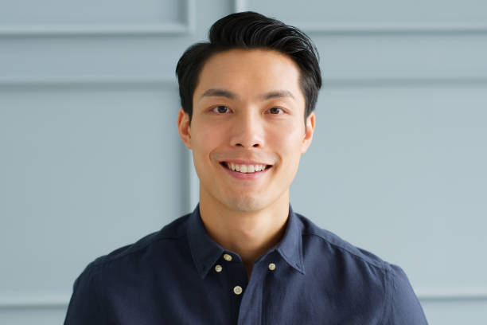
Persona 1
Name: David Kim
Age: 42
Occupation: Construction Project Manager
Education: Bachelor's degree in Civil Engineering
Personality: David is a hard-working and responsible individual who takes pride in his work. He is a detail-oriented person who pays close attention to his surroundings and is always looking for ways to improve processes. He is also health-conscious and enjoys staying active by jogging and playing basketball with his friends.
Interests: David is interested in technology and enjoys exploring new apps and software. He is also an advocate for sun safety and spends a lot of time outdoors due to his job, which has increased his risk of skin cancer. He enjoys learning about new ways to protect his skin and stay healthy.
Goals: David's main goal is to excel in his career and take on larger construction projects. He also wants to continue leading an active and healthy lifestyle, which includes monitoring his skin for signs of skin cancer. He hopes to use technology to help him achieve his health goals and stay informed about the latest developments in sun protection.
Challenges: David faces challenges in balancing his demanding job with his personal life. He also struggles with keeping track of his skin health, as it can be difficult to remember to check his skin for changes regularly. He hopes to use a skin cancer detection app to help him monitor his skin and catch any potential issues early on. However, he is also concerned about the accuracy of such apps and wants to ensure that he is using a reliable and trustworthy tool.

Slide 7

Persona 2
Name: Emily Rodriguez
Age: 29
Occupation: Outdoor Recreation Guide
Education: Associate's degree in Outdoor Recreation
Personality: Emily is a nature enthusiast who is passionate about sharing her love of the outdoors with others. She is outgoing and adventurous, and enjoys exploring new trails and camping sites. She is also conscientious and takes her responsibility for the safety of her clients seriously.
Interests: Emily enjoys hiking, backpacking, and rock climbing in her free time. She is also interested in technology and is always looking for ways to use it to enhance her clients' experiences. She is particularly interested in skin cancer prevention and is looking for ways to incorporate sun safety into her job.
Goals: Emily's main goal is to help her clients have a safe and enjoyable experience in the great outdoors. She also hopes to use technology to help her monitor her own skin health and catch any potential issues early on. Additionally, she wants to continue exploring new outdoor adventures and sharing them with others.
Challenges: Emily faces challenges in keeping track of her skin health while spending long hours outdoors. She hopes to use a skin cancer detection app to help her monitor any changes in her skin, but is concerned about the reliability of such tools. She also struggles with work-life balance at times, as her job requires her to spend long hours in the outdoors.

Slide 8

Persona 3
Name: Thomas Lee
Age: 45
Occupation: Sales Manager
Education: Bachelor's degree in Marketing
Personality: Thomas is a confident and charismatic person who enjoys interacting with people. He is skilled at building relationships and is always looking for ways to improve his sales numbers. He is also health-conscious and takes his sun safety seriously.
Interests: Thomas enjoys playing golf and is a member of a local golf club. He also enjoys traveling with his family and experiencing new cultures. He is interested in technology and is always looking for ways to use it to improve his work and personal life.
Goals: Thomas's main goal is to increase his sales and advance in his career. He also hopes to use technology to help him monitor his skin health and catch any potential issues early on. Additionally, he wants to continue playing golf and spending time with his family.
Challenges: Thomas faces challenges in keeping track of his skin health while spending long hours outdoors meeting with clients. He hopes to use a skin cancer detection app to help him monitor any changes in his skin, but is concerned about the accuracy of such tools. He also struggles with work-life balance at times, as his job requires him to travel frequently and spend long hours working.

Slide 9
Minimum Viable Product
A website that allows for simple input and output with a predicted degree of certainty.
Implementation of a Machine Learning Model with sufficient testing and training sample size.
A cross-platform website that is responsive and device agnostic.

Slide 10



Current Technologies Utilized
Front End: HTML, CSS, JavaScript, React, Ionic, Axios
Back End: Python, Django, Django REST, TensorFlow, Keras
Python Package Dependencies: NumPy, Matplotlib, OpenCV, Pillow (PIL)
Other Technologies Used: Google Authenticator, Github, Git, Visual Studio Code (VSCode), Google Colaboratory, Jira, Photopea
Note: This is the list of technologies employed for the MVP only.

Slide 11
Algorithms
Image Recognition → Convolution Neural Network
Three separate ”stacks” of 2D layers:
Convolution Layer with ReLU activation
Max Pooling Layer
Drop Out Layer
Flatten Layer
Dense Layer
**ADD IMAGE HERE TO EXPLAIN**

Slide 12
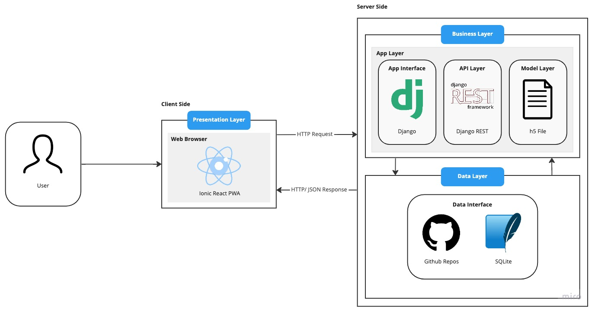
Diagrams: Architecture

Slide 13
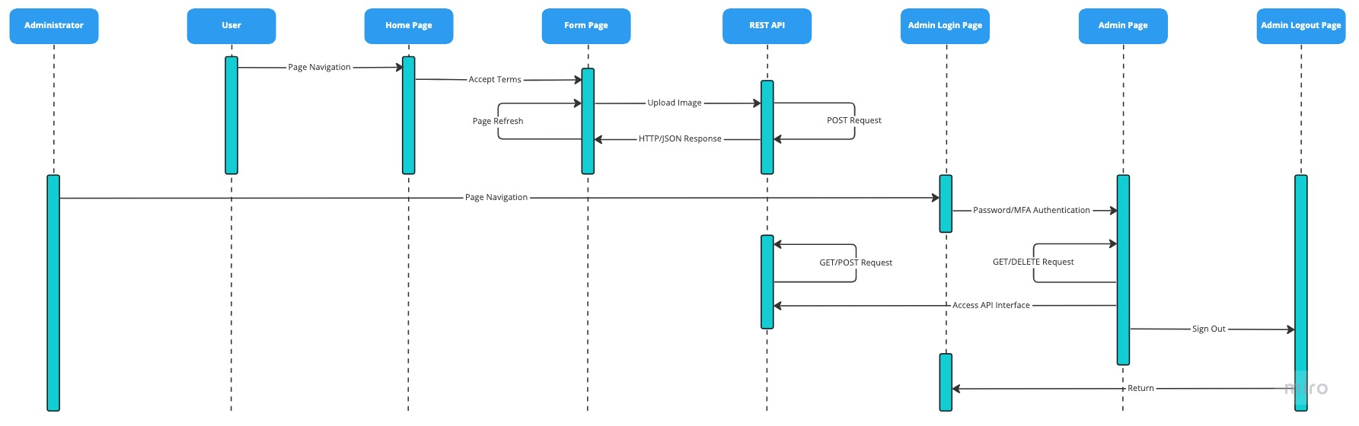
Diagrams: User Sequence

Slide 14
Product Backlog
Issue Type | Key | Description
Task | CAP-1 | Add Django to Keras model
Task | CAP-2 | Add DRF to Keras model
Task | CAP-3 | Add a new model to optimize
Task | CAP-4 | Add more training data
Task | CAP-5 | Determine if celery is needed
Task | CAP-6 | Confirm if from front end to back end image bit path can be passed
Task | CAP-7 | Determine front end architecture
Task | CAP-8 | Determine backend web hosting
Task | CAP-9 | Implement Back End Web Hosting
Task | CAP-10 | Implement Front End Web Hosting
Task | CAP-12 | Image resizing from DRF interface to Keras model
Task | CAP-13 | Initial documentation within code
Task | CAP-14 | Enforce consistent coding style
Task | CAP-15 | Unit testing: Back End
Task | CAP-16 | End-to-End testing: Front End
Task | CAP-17 | End-to-End testing: Back End
Task | CAP-22 | Create intial ML model
Task | CAP-23 | Redo DRF backend
Task | CAP-24 | Token authentication on Django Admin
Task | CAP-25 | Combine DRF applications together
Task | CAP-27 | Capacitor/Cordova Implementation
Task | CAP-28 | Add API Key
Task | CAP-29 | Develop front end from wireframe
Task | CAP-30 | Implement Ion Loading
Task | CAP-31 | Add menu functionality
Task | CAP-32 | Presentation
Task | CAP-33 | Technical paper
Task | CAP-34 | Create Wiki Page
Task | CAP-35 | AWS S3 Buckets
Story | CAP-37 | As a user I want to be able to use this on any device
Story | CAP-38 | As a user I want to chat with someone or find out more information regarding the website
Story | CAP-39 | As a user I want to have instant feedback as well as detailed feedback
Story | CAP-40 | As a user I want this to have reliable and provide information about the data
Story | CAP-41 | As a user I want to be warned that this does not replace a physician and that I should know that before using it
Story | CAP-42 | As a user I want to interface to be easy to understand
Story | CAP-43 | As a user I want my data to be protected
Story | CAP-44 | As a user I want to take a photo and send it without having the photo save to my phone first

Slide 15
Catalyst 1 Backlog
Issue Type | Key | Description
Task | CAP-1 | Add Django to Keras model
Task | CAP-2 | Add DRF to Keras model
Task | CAP-5 | Determine if celery is needed
Task | CAP-6 | Confirm if from front end to back end image bit path can be passed
Task | CAP-7 | Determine front end architecture
Task | CAP-8 | Determine backend web hosting
Task | CAP-12 | Image resizing from DRF interface to Keras model
Task | CAP-13 | Initial documentation within code
Task | CAP-22 | Create intial ML model
Task | CAP-23 | Redo DRF backend
Task | CAP-24 | Token authentication on Django Admin
Task | CAP-25 | Combine DRF applications together
Task | CAP-29 | Develop front end from wireframe
Task | CAP-31 | Add menu functionality
Task | CAP-32 | Presentation
Task | CAP-33 | Technical paper
Task | CAP-34 | Create Wiki Page
Story | CAP-37 | As a user I want to be able to use this on any device
Story | CAP-41 | As a user I want to be warned that this does not replace a physician and that I should know that before using it
Story | CAP-42 | As a user I want to interface to be easy to understand
Story | CAP-43 | As a user I want my data to be protected

Slide 16
User Stories and Acceptance Criteria

Slide 17
Test Cases

Slide 18
Stories Completed
Issue Type | Key | Description
Story | CAP-37 | As a user I want to be able to use this on any device
Story | CAP-41 | As a user I want to be warned that this does not replace a physician and that I should know that before using it
Story | CAP-42 | As a user I want to interface to be easy to understand
Story | CAP-43 | As a user I want my data to be protected

Slide 19
Team Velocity

Slide 20
Burndown Charts

Slide 21
Catalyst 2 Backlog
Issue Type | Key | Description
Story | CAP-44 | As a user I want to take a photo and send it without having the photo save to my phone first
Story | CAP-40 | As a user I want this to have reliable and provide information about the data
Story | CAP-39 | As a user I want to have instant feedback as well as detailed feedback
Story | CAP-38 | As a user I want to chat with someone or find out more information regarding the website
Task | CAP-30 | Implement Ion Loading
Task | CAP-3 | Add a new model to optimize
Task | CAP-4 | Add more training data
Task | CAP-9 | Implement Back End Web Hosting
Task | CAP-10 | Implement Front End Web Hosting
Task | CAP-14 | Enforce consistent coding style
Task | CAP-15 | Unit testing: Back End
Task | CAP-16 | End-to-End testing: Front End
Task | CAP-17 | End-to-End testing: Back End
Task | CAP-27 | Capacitor/Cordova Implementation
Task | CAP-28 | Add API Key
Task | CAP-35 | AWS S3 Buckets

Slide 22
Introduction
With PowerPoint, you can create presentations and share your work with others, wherever they are. Type the text you want here to get started. You can also add images, art, and videos on this template. Save to OneDrive and access your presentations from your computer, tablet, or phone.

Slide 23

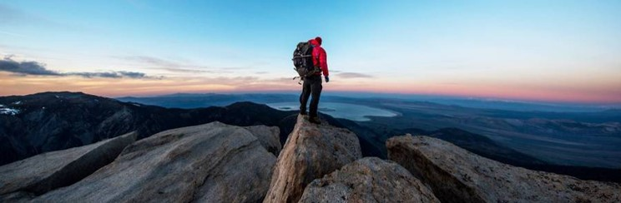
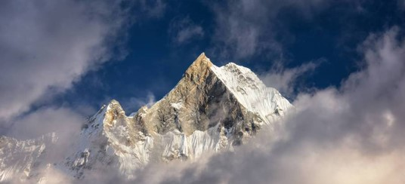
Topic one
Subtitle

Slide 24
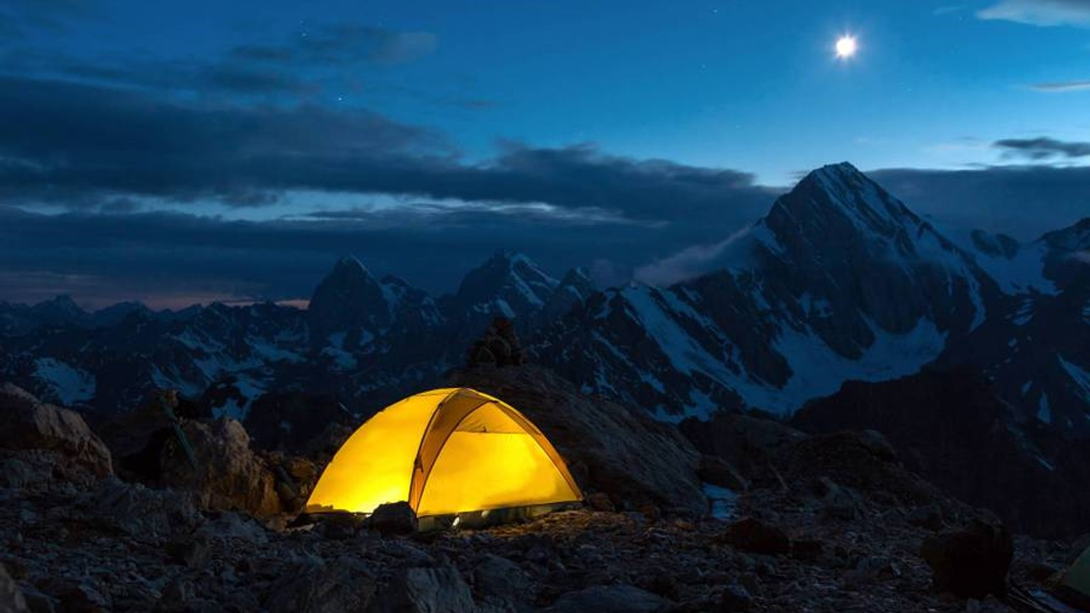
The way to get started is to quit talking and begin doing.
Walt Disney

Slide 25
Timeline
Title
To start a presentation, go to the Slide Show tab, and select From Beginning.
Title
To display Presenter view, in Slide Show view, on the control bar at the bottom left select the three dots, and then Show Presenter View.
Title
During your presentation, the speaker notes are visible on your monitor, but aren't visible to the audience.
Title
The Notes pane is a box that appears below each slide. Tap it to add notes.
Title
If you don’t see the Notes pane or it is completely minimized, click Notes on the task bar across the bottom of the PowerPoint window.

Slide 26
Content
Subtitle
Subtitle
Add text, images, art, and videos.
Add transitions, animations, and motion.
Save to OneDrive, to get to your presentations from your computer, tablet, or phone.
Open the Design Ideas pane for instant slide makeovers.
When we have design ideas, we’ll show them to you right there.

Slide 27
Additional content
Subtitle
Subtitle
Subtitle
Add text, images, art, and videos.
Add transitions, animations, and motion.
Save to OneDrive, to get to your presentations from your computer, tablet, or phone.
This PowerPoint theme uses its own unique set of colors, fonts, and effects to create the overall look and feel of these slides.
PowerPoint has tons of themes to give your presentation just the right personality.
Open the Design Ideas pane for instant slide makeovers.
When we have design ideas, we’ll show them to you right there.

Slide 28
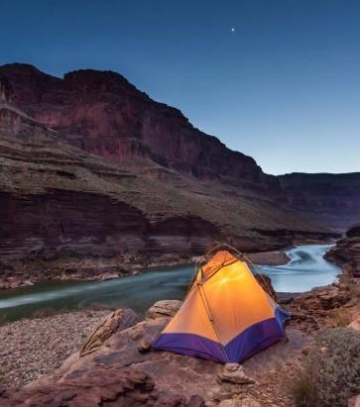

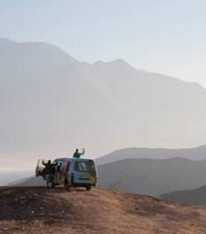
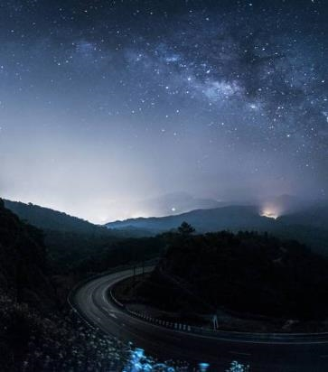
Summary
With PowerPoint, you can create presentations and share your work with others, wherever they are. Type the text you want here to get started. You can also add images, art, and videos on this template. Save to OneDrive and access your presentations from your computer, tablet, or phone.

Slide 29


Thank you
Presenter name
Email address
Website

